Slide 1

Iot plant monitoring system

Slide 2
Purpose of the project
Implement an autonomous system for the monitoring of plant.
Various sensors to collect measurements from the plant.
Autonomous watering.
MQTT communication.
Raspberry Pi broker.
E-mail notifications.
Real-time measurements charts.

Slide 3
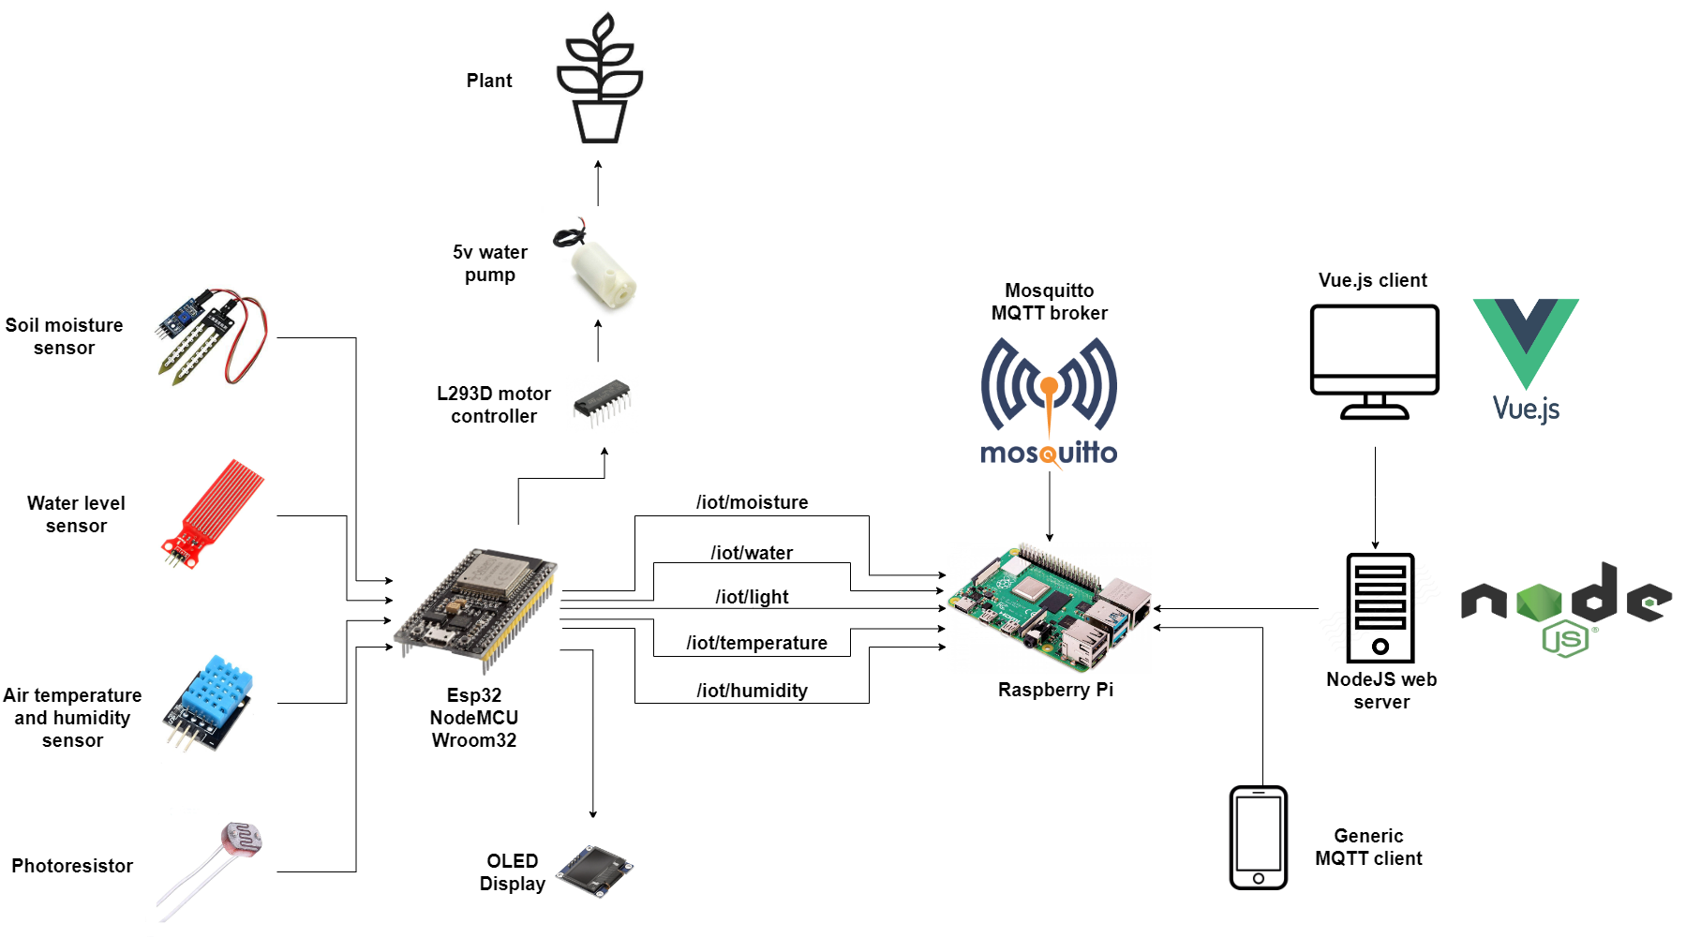
System architecture

Slide 4
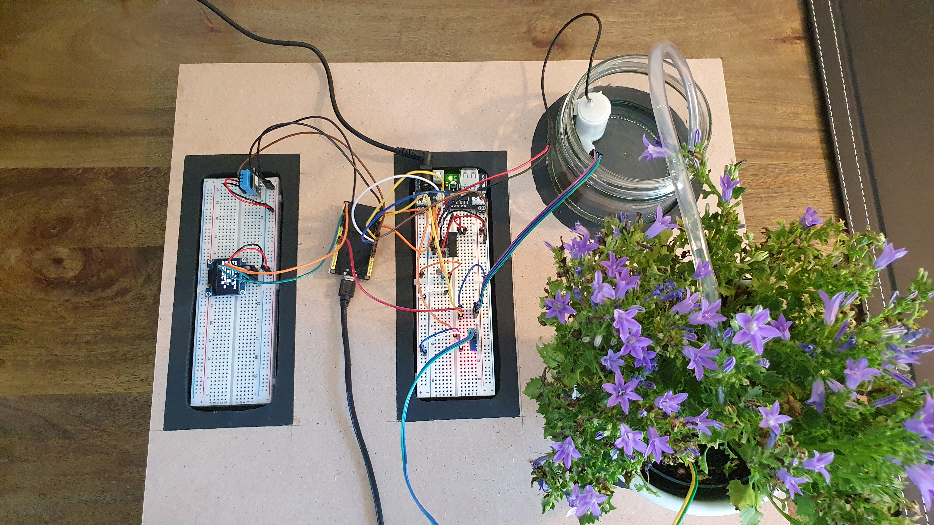
System architecture

Slide 5
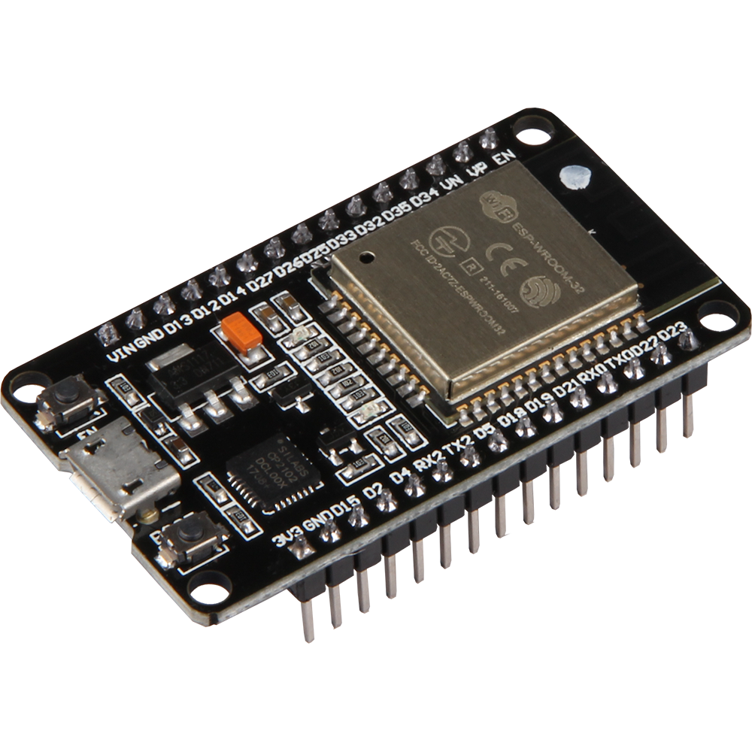
Hardware – esp32
Built-in WiFi and Bluetooth.
Greater memory size compared to Arduino Uno.
Increased number of pins.

Slide 6
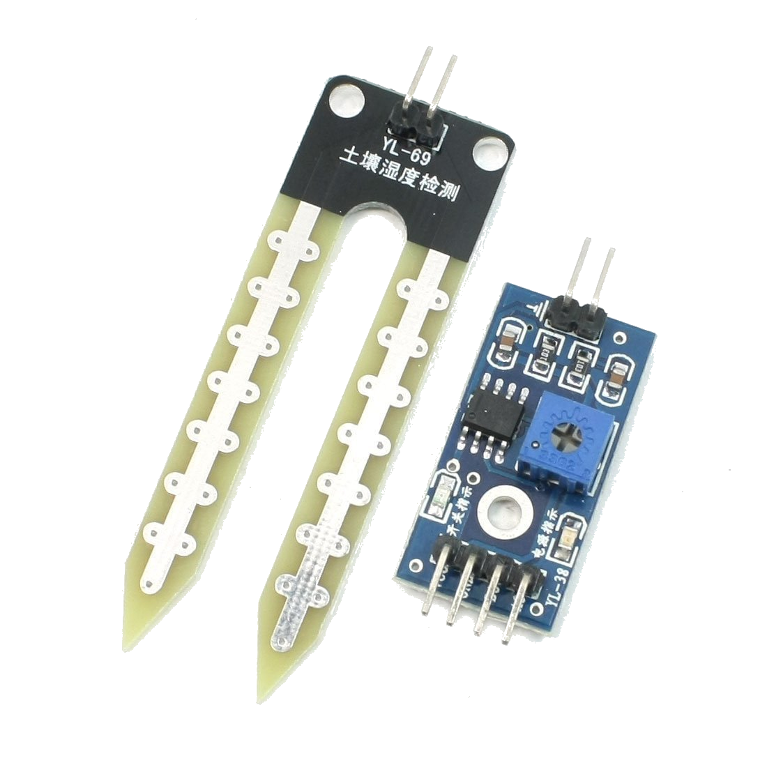
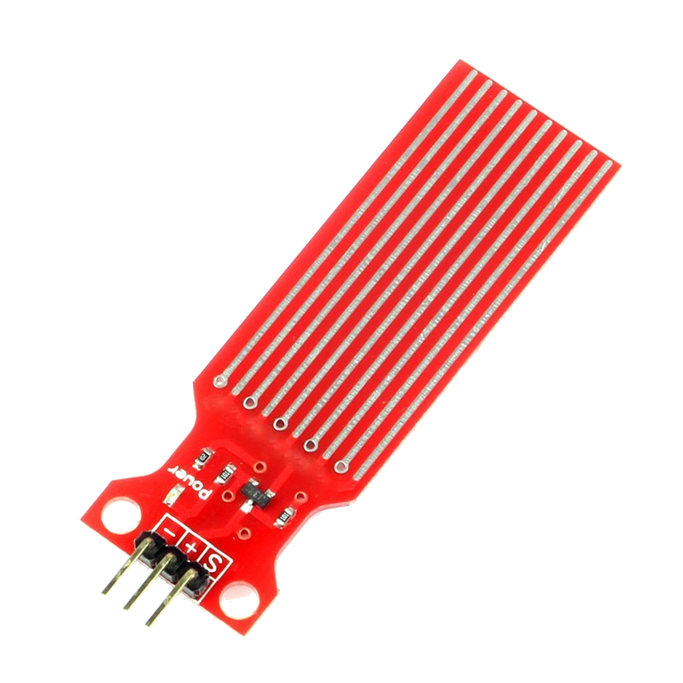
HARDWARE - SENSORS
Soil moisture
Measures how wet the soil is.
Used to determine when to activate the pump.
Water level
Measures how much water remains.

Slide 7
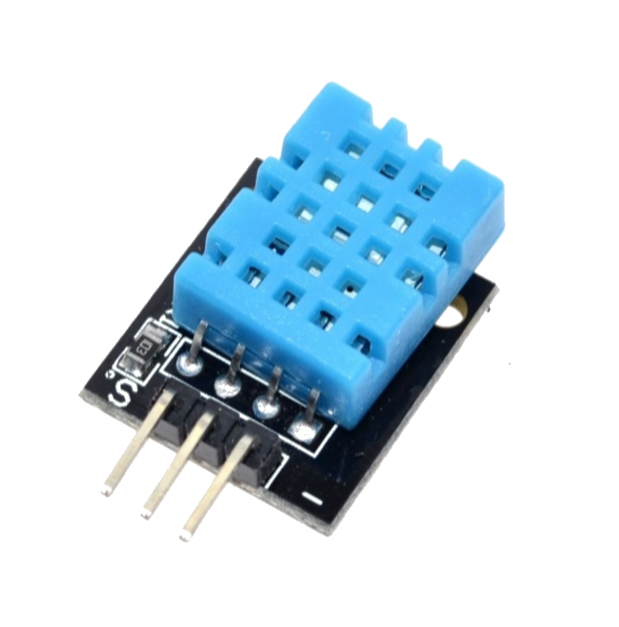
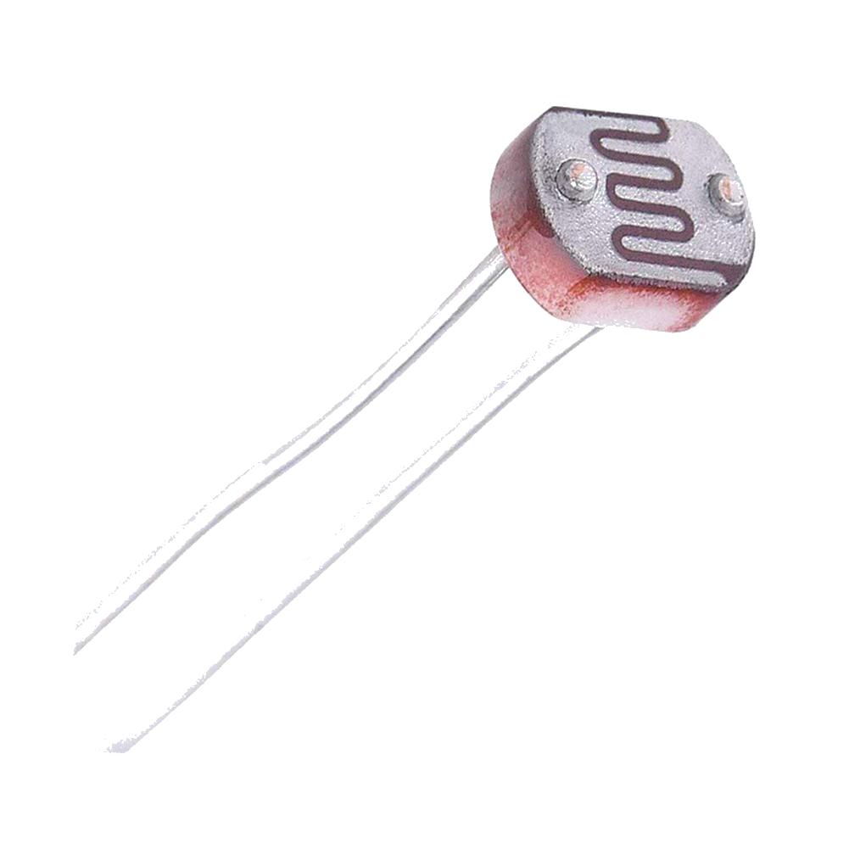
HARDWARE - SENSORS
Air HUMIDITY AND TEMPERATURE
PHOTORESISTOR
Measures the light level near the plant.

Slide 8
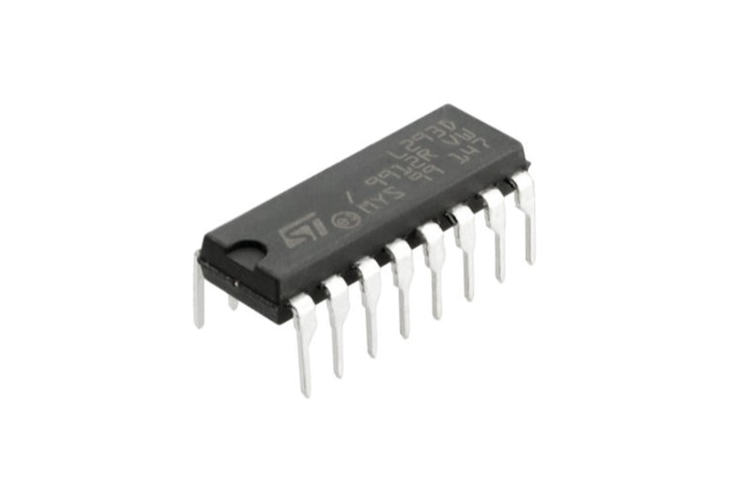
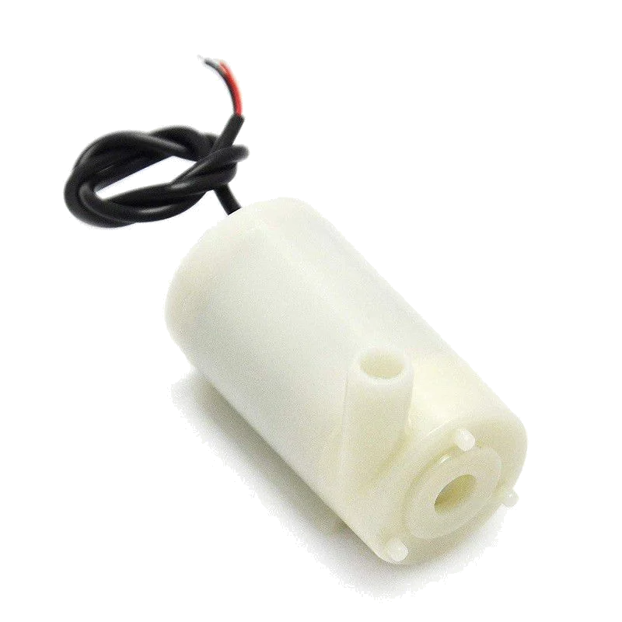
HARDWARE – Controller and pump
L293d motor driver
Can control up to 2 pumps at once.
5v water pump
Sits in water
Triggers based on soil moisture levels.

Slide 9

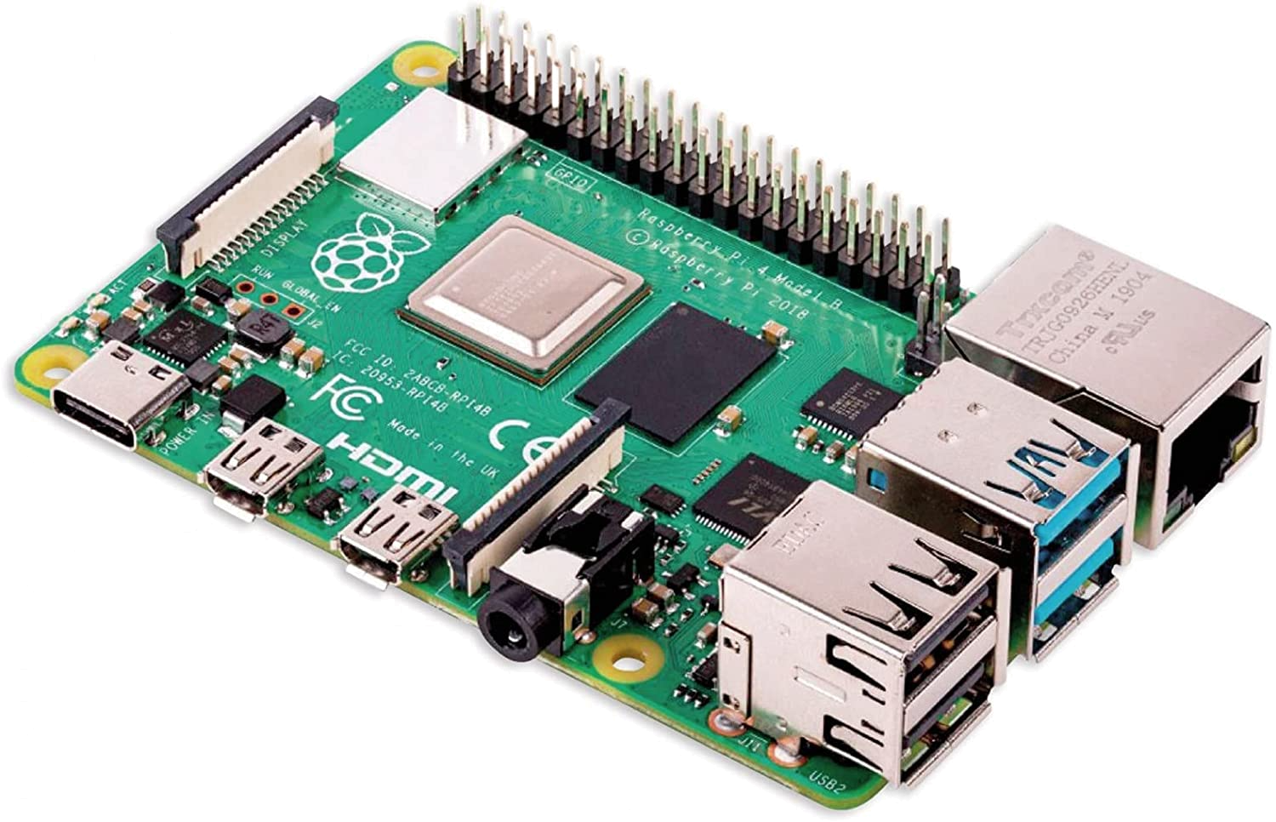
MQTT COMMUNICATION
Mosquitto broker running on a Rapsberry Pi:
Collects messages from ESP32.
Web server subscribes to topics.
A topic for each measurement:
/iot/moisture
/iot/water
/iot/light
/iot/temperature
/iot/humidity

Slide 10
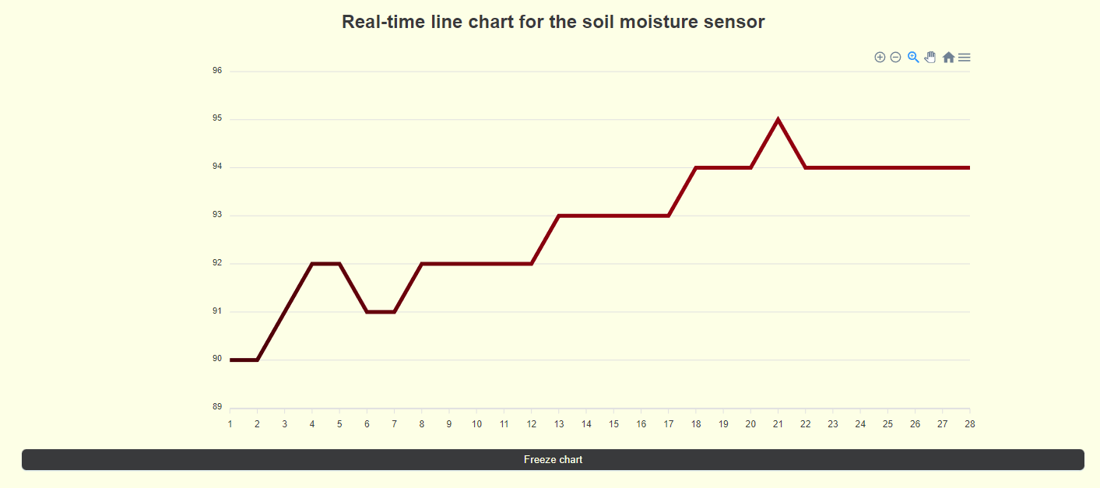
Moisture level real-time chart

Slide 11
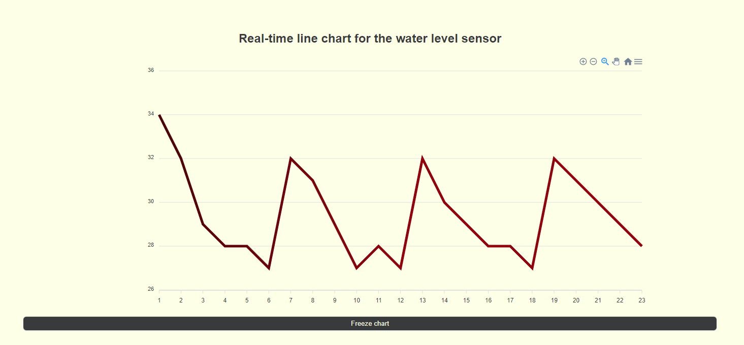
Water level real-time chart

Slide 12
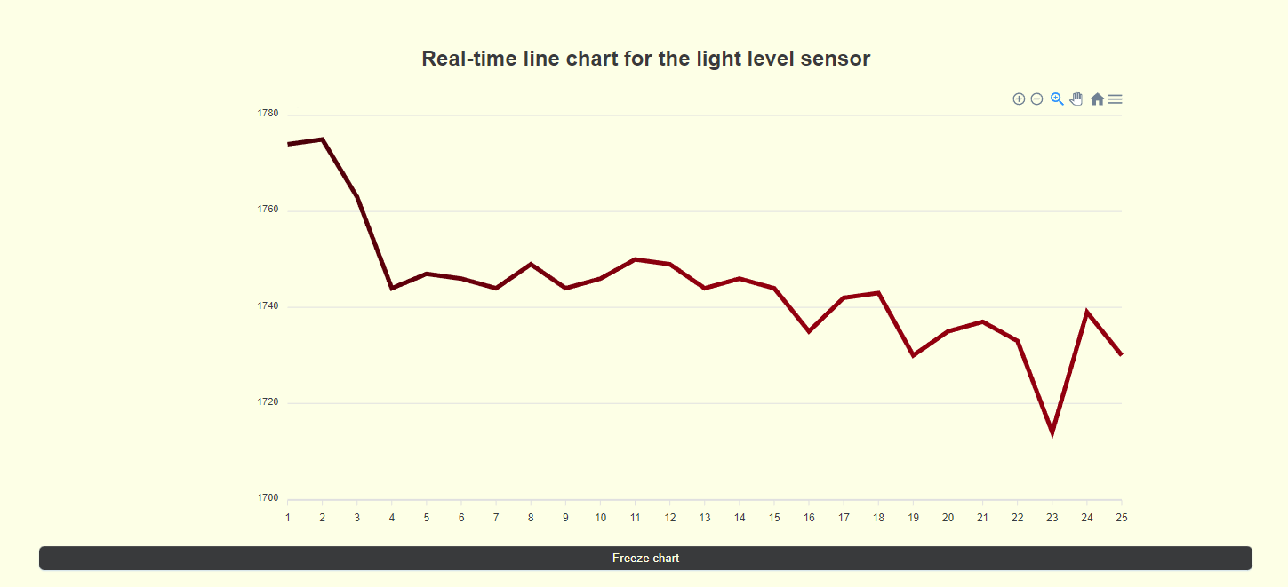
LIGHT LEVEL REAL-TIME CHART

Slide 13
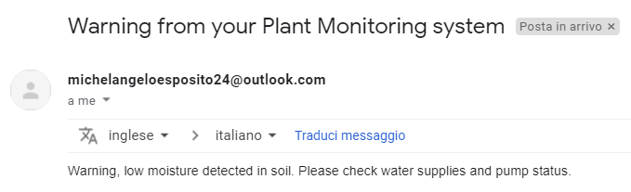
E-MAIL NOTIFICATION
Anomalies can be detected in the measurements, i.e.:
Low water level in the reserve.
Dangerous values for temperature/light…
In case this happens, the user is notified vie e-mail.

Slide 14
Thank you for the attention!

